Slide 1

Presentation of the CseGe kft. Network Prototype
Made by: Elekes Bálint, Győrfi Dániel, Szőts Dávid

Slide 2
Introduction Bálint Elekes- Project Manager and Lead Network Configuration Specialist
Main tasks:
Designing and implementing the complete network architecture Detailed configuration of routers and switches in Cisco Packet Tracer Setting up VLANs and inter-VLAN routing (router-on-a-stick / multilayer switch) Configuring network security solutions: ACLs, Port Security, NAT, DHCP, DNS, FTP, and web services
Routing settings (statikus routs, OSPF)
Deploying a multilayer switch in the development network
Monitoring network operation and troubleshooting issues
Contribution to the project:
Key role in the technical implementation of the network
Developing a secure and functional corporate network prototype
Professional guidance and technical coordination of the project
Notes:
Hello everyone. My name is Bálint Elekes, and I was the project manager and lead network configuration specialist.
My main job was to design and organize the whole network structure. I configured the routers and switches and made sure every department can communicate safely.

Slide 3
Dániel Győrfi – Network Design and Basic Configuration
Main Tasks:
Designing the logical and physical structure of the network
Contribution to the Project:
Establishing site and department-level network structure Providing a stable foundation for further configurations
Basic configuration of routers and switches
Creating VLANs and connecting endpoints
Planning IP addressing (static and dynamic)
Testing connections (ping, traceroute)
Notes:
My name is Győrfi Dániel. On this slide, my role in the project is presented. My main responsibility was designing both the logical and physical structure of the network.
This included the basic configuration of routers and switches, creating VLANs, and connecting endpoints.
I also participated the IP address planning using both static and dynamic addressing, and tested the network connectivity using tools like ping and traceroute.

Slide 4
Dávid Szőts – Project administration and support
Main tasks:
Create, update and track Jira tasks
Contribution to the project:
Ensuring project transparency using Jira
Manage time spent (worklog) Complete network configuration tasks more easily Support testing process (record PASS / FAlL cases)
Addition and review documentation
Administrative and technical support for the team
Assisting with testing and documentation tasks
Notes:
My name is Dávid Szőts, and in this project I was responsible for project administration and support.

Slide 5
Brief overview of CseGe Kft.
The network models the operation of a medium-sized company with multiple departments
The network is segmented with VLANs, each department having its own subnet
Inter-VLAN routing enables communication between VLANs
Core network services include:
DHCP
DNS
FTP and Web server
Security is ensured via ACLs, port security, and NAT
The prototype was created in Cisco Packet Tracer, simulating a real corporate environment
Notes:
The network represents a medium-sized company with multiple departments.
Each department has its own VLAN and subnet. Inter-VLAN routing enables communication, and core services like DHCP, DNS, FTP, and Web are included.
Security is provided by ACLs, port security, and NAT.

Slide 6
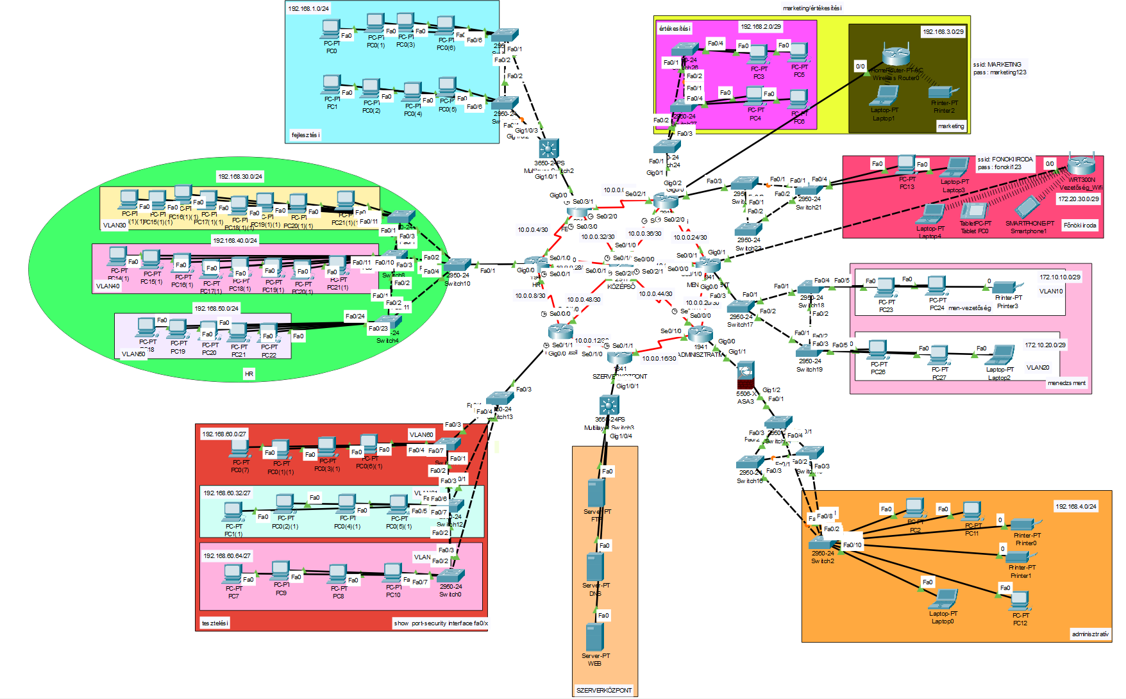
The whole Prototype
Notes:
This slide shows the complete network prototype of CseGe Kft.
The network connects multiple departments through a central network.
Each department has its own subnet and VLAN to improve organization and security.

Slide 7
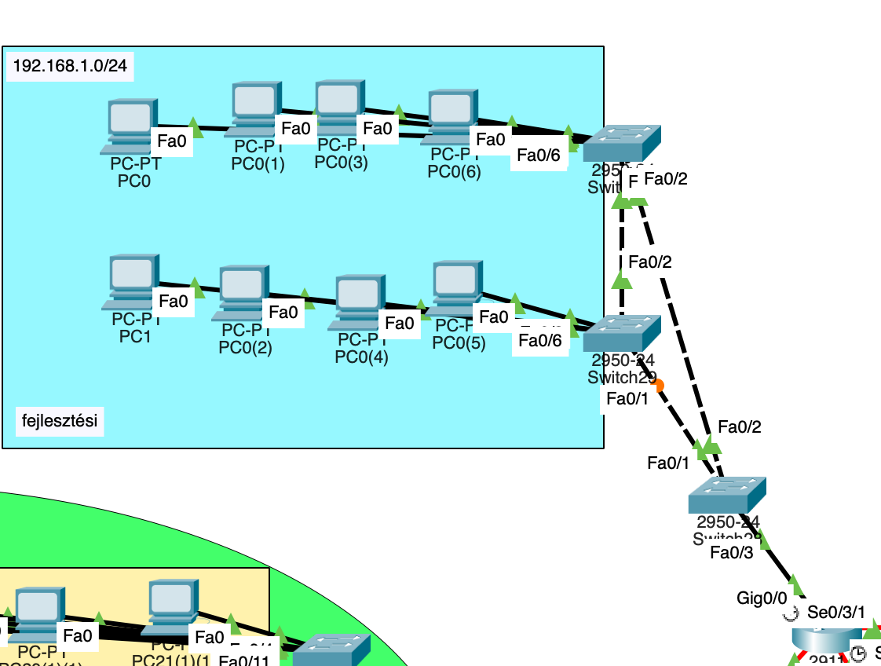

Development Department
Router: FEJLESZTESI
VPN endpoint: Tunnel0 – 172.16.10.1
IPv6 Dual Band
Functions:
DHCP, DNS, VPN connections
Static route: 192.168.2.0 → via VPN
RIP network participation (10.0.0.0 + 192.168.1.0)
Notes:
This is the Development department network.
Here we use DHCP, DNS and VPN services. The router connects this department to other sites through a secure VPN tunnel.
We also use static routing and RIP to share network information. This ensures stable and continuous communication with other departments.

Slide 8
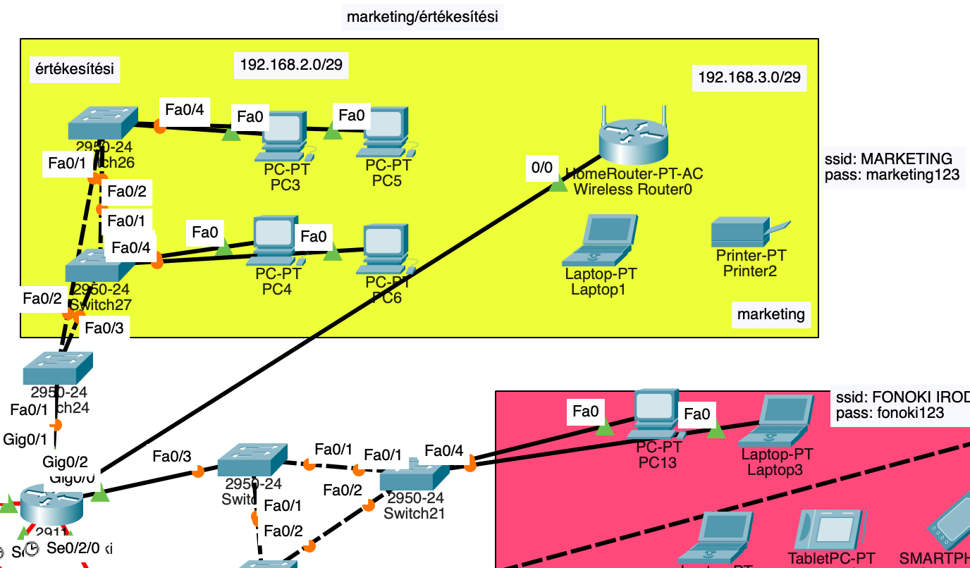
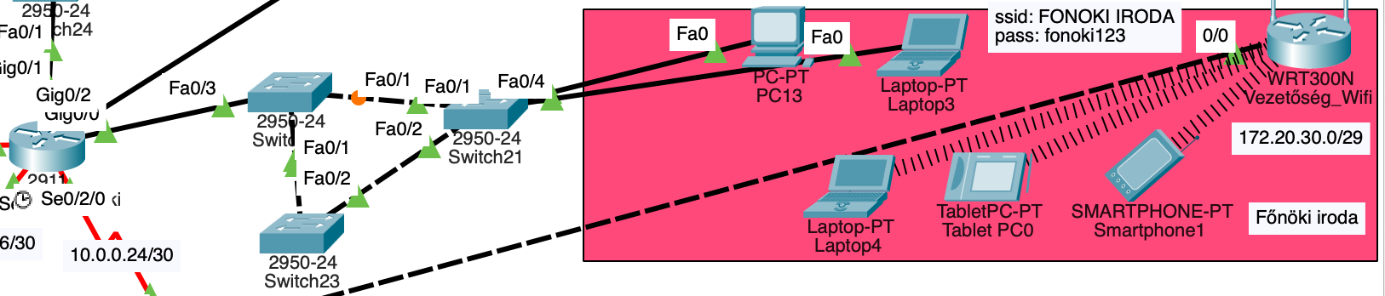
Marketing/Sales Department, Executive Office
Router: MAR/ERT_Fonoki
Classes:
Marketing/Sales
Boss office
LAN at Boss office
Wifi router LAN
Functions:
VPN connection to Development site (172.16.10.2)
DHCP 3 for 3 separate networks
RIP + static route
Notes:
This network belongs to the Marketing and Executive office.
There are separate networks for the office and for WiFi users. We configured DHCP for each network so devices get IP addresses automatically.
This department is also connected to the Development site with VPN. Routing helps the networks communicate properly.

Slide 9
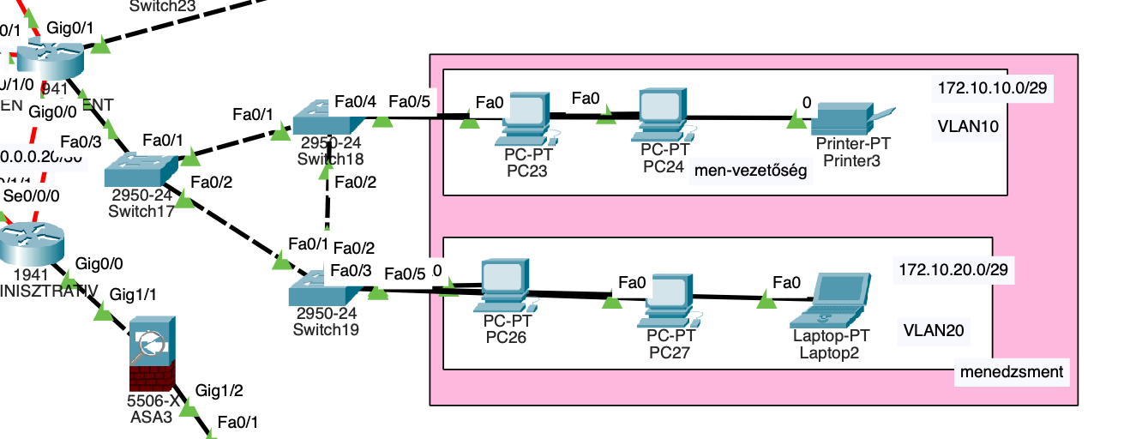
Management department
Router: MENEDZSMENT
VLANs: 10, 20
ACL 101 protects traffic between the two VLANs
DHCP separate pools: management10 / management20
Notes:
The management department is separated into two VLANs, VLAN 10 and VLAN 20.
Traffic between these VLANs is controlled by ACL 101, which limits communication to only what is necessary.
Each VLAN has its own DHCP pool, ensuring automatic and separate IP address allocation. This design improves both security and traffic control, which is especially important for management-level networks.

Slide 10
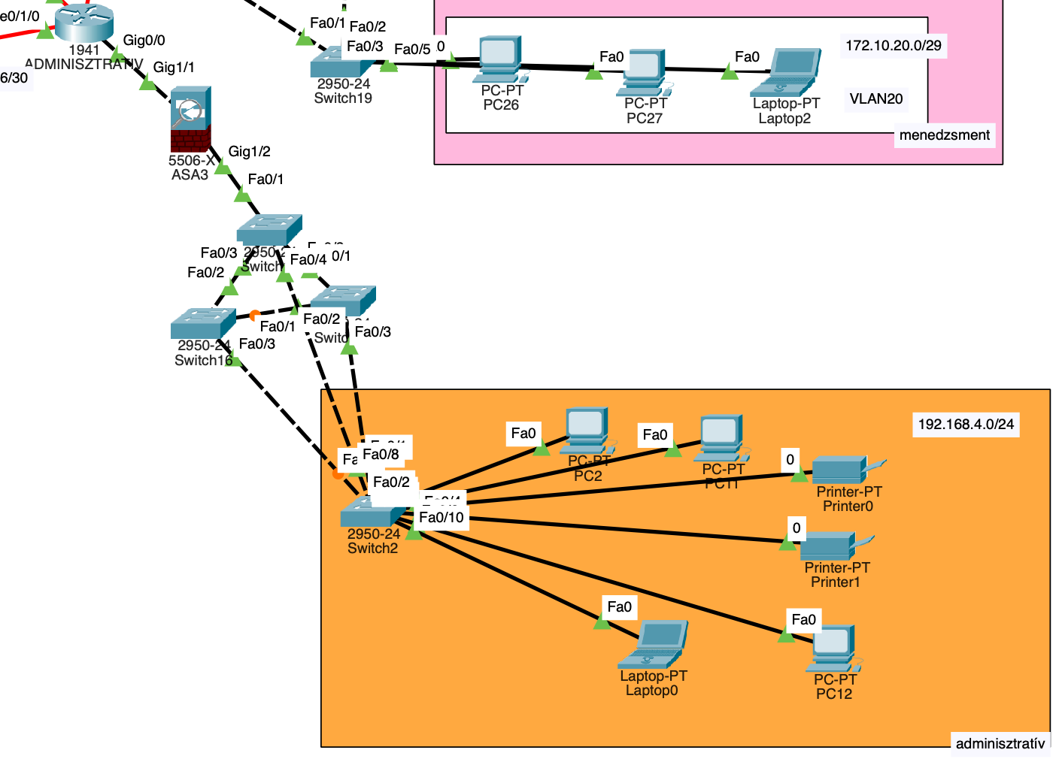
Administrative department
Router: ADMINISZTRATIV
Connected to ASA2 firewall (Gig0/0 ↔ ASA outside 10.0.16.0/30)
DHCP: 192.168.4.0/24
RIP + static route
ASA functions:
NAT (inside ↔ outside)
Security levels: inside 100, outside 0
Allows traffic only from inside out
Notes:
This is the Administrative department.
It is protected by an ASA firewall. The firewall allows traffic from inside to outside, but blocks unsafe incoming traffic.
We also use NAT to allow internal devices to access external networks safely.
This increases the security of the company.

Slide 11
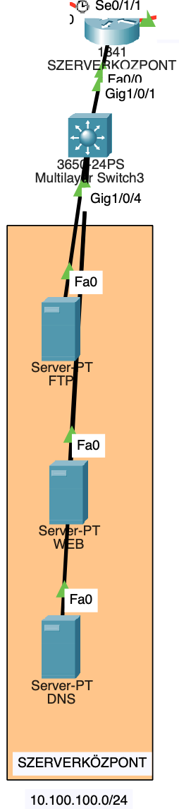
Server center
Router: SZERVERKOZPONT
Includes:
FTP server
DNS server
Web server
Web accessible via DNS name: csegekft.com
RIP connection to the core network
Notes:
This slide presents the server center of the network.
It uses the SZERVERKOZPONT router and includes three main servers: an FTP server, a DNS server, and a web server.
The web server is accessible using the domain name csegekft.com.
The server center is connected to the core network using RIP routing, which allows communication with all departments.

Slide 12
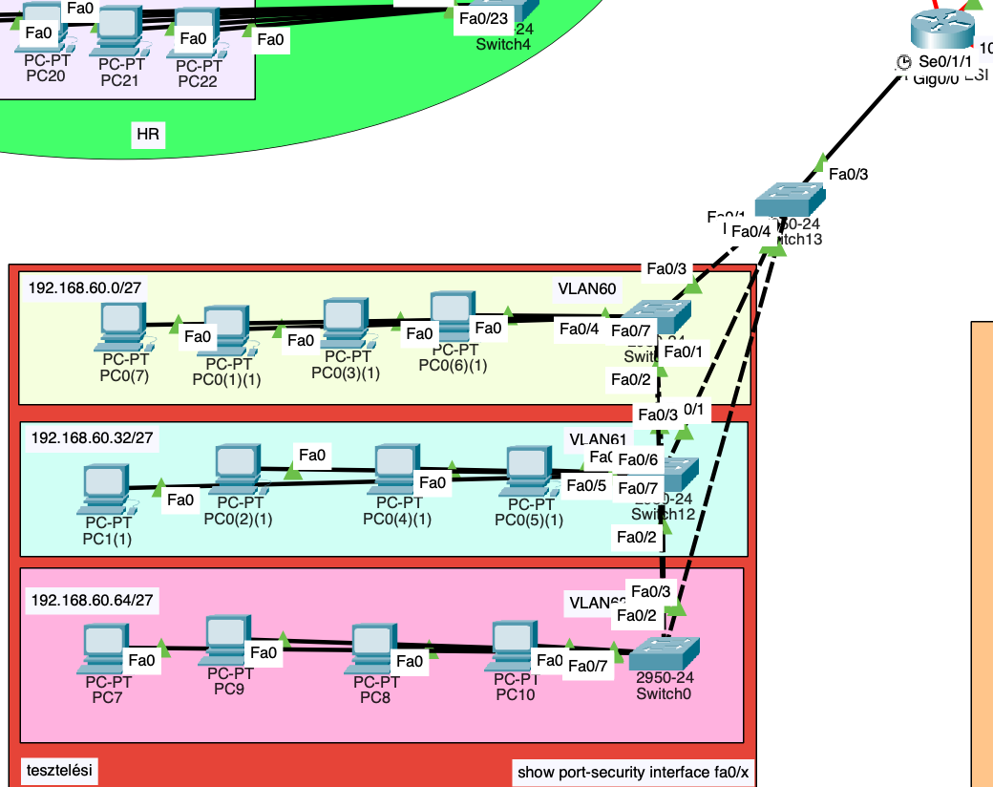
Testing class
Router: TESZTELESI
VLANs: 60, 61, 62
Trunk connection to the switch DHCP for VLANs
Switch security:
Port Security (max 2 MACs, restrict)
PortFast, BPDU Guard
Sticky MAC addresses configured
Notes:
The testing class uses three VLANs: 60, 61, and 62.
A trunk connection is configured between the router and the switches to support multiple VLANs.
Each VLAN receives IP addresses dynamically through DHCP.
In this section we made port security on switches, which enables maximum two MAC adresses on each port.

Slide 13
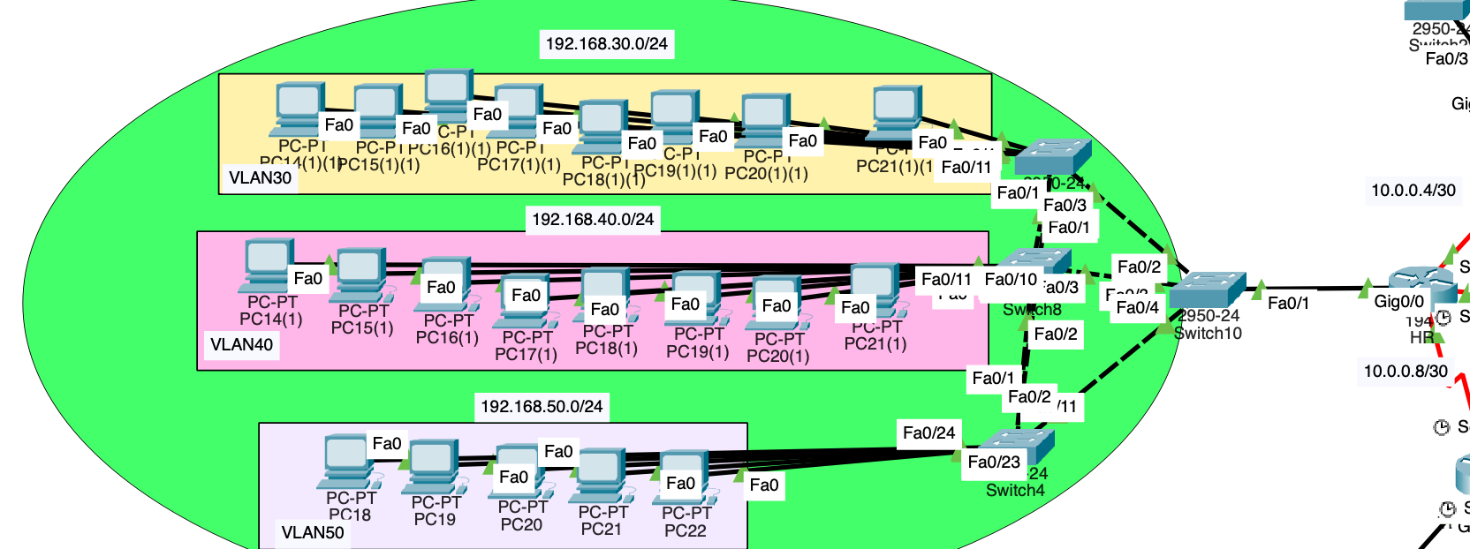
HR class
Router: HR
VLANs: 30, 40, 50
DHCP different subnet mask
RIP routing 10.0.0.0 + 192.168.x.x networks
Notes:
This slide shows the HR class network.
The HR router manages VLANs 30, 40, and 50, which separate the network into different segments.
Each VLAN uses DHCP with a different subnet mask. Routing is handled using RIP, allowing communication between the networks

Slide 14

What is the GIT?
Open-source version control system)
Tracks changes in source code and configurations
Manages versions and branches
Allows reverting to previous states
Integrates with GitHub and other repositories
Notes:
Git is a version control system.
It helps track changes in source code and configurations. We can manage different versions and branches.
If something goes wrong, we can return to a previous version.

Slide 15
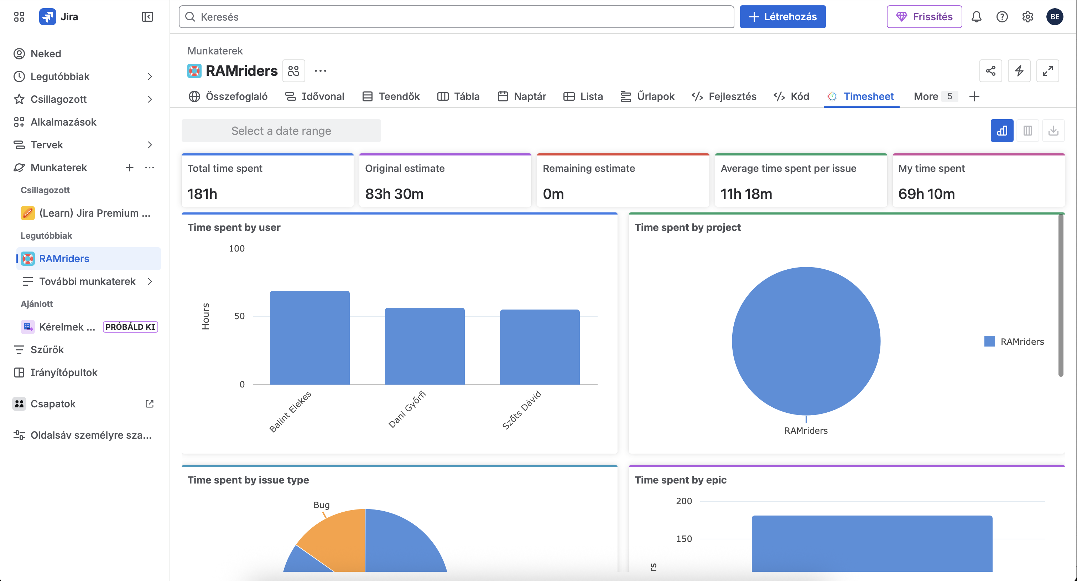
What is the JIRA?
Project and task management tool (by Atlassian)
Issue and task tracking
Team collaboration and deadline management
Transparent workflow and status tracking
Time tracking and reporting
Notes:
this slide explains what JIRA is.
JIRA is a project management and issue-tracking tool.
It is used to plan and document IT, network, and development projects.
With JIRA, we can assign tasks, track progress, and manage deadlines.
It also improves teamwork by making all tasks, changes, and time tracking transparent and traceable.

Slide 16
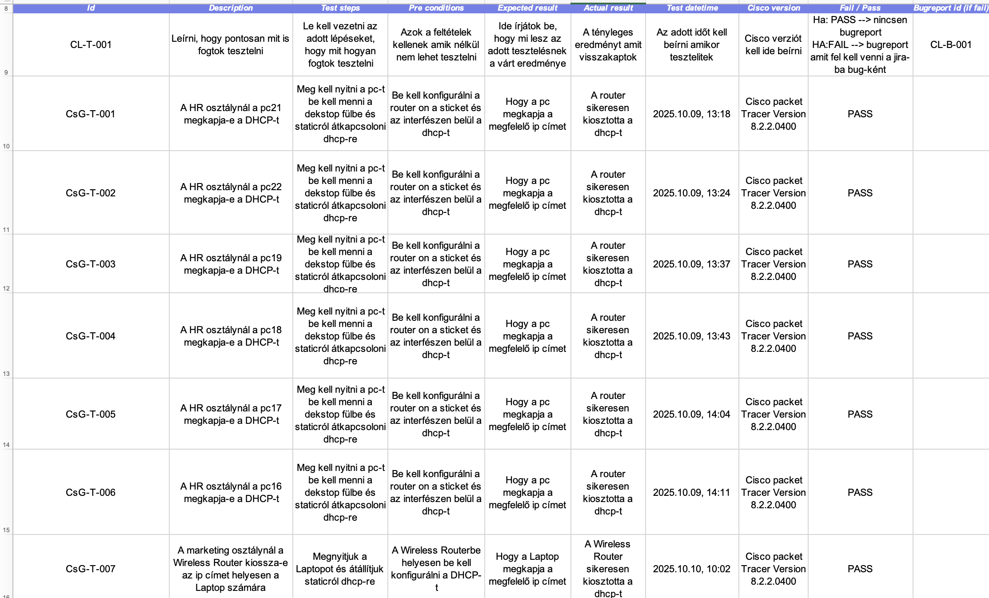
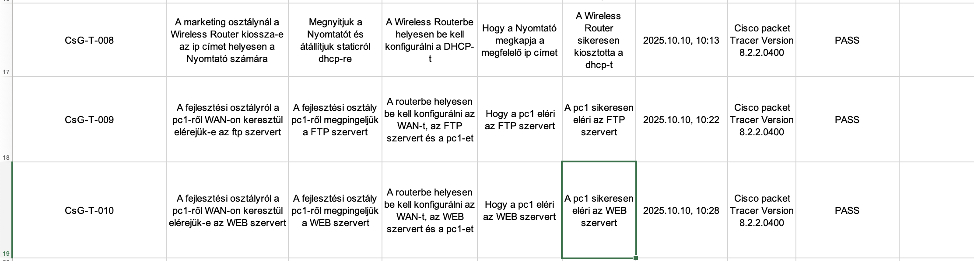
Testing scheme
Notes:
This slide shows our testing scheme. It contains a hundred tests with Fail and Pass procedures. We can tarck back our work and find our mistakes with this.

Slide 17
Our future plans
Building a faster and more scalable infrastructure
Implementing cloud integration
Further improving network security
Notes:
First, we're building a faster and more scalable infrastructure to handle growing demand.
Second, we're integrating cloud solutions to make our systems more flexible.
And finally, we're continuously improving our network security to stay ahead of threats.

Slide 18
Overview
Fully functional multi-site corporate network
VPN connection between headquarters and branches
DNS + Web integration
Complete network security (firewall, ACL, port-security)
Notes:
In summary, we created a fully functional multi-site corporate network.
The sites are connected with VPN. We implemented DNS and web services.
Security was very important, so we used firewall, ACL and port security.
Our goal was to build a stable, secure and scalable company network.

Slide 19
Thank you for your attention. ☺
We look forward to your questions

